Slide 1
Daffodil International University
Assignment
Course: Financial & Managerial Accounting
Subject Code: ACT-211
Submitted to:
Repon Miah Senior Lecturer in Accounting Department of Business Administration Daffodil International University
Submitted by:
Name: Ismail Hasan Sarker
ID: 181-15-1815
Section: PC-C
Department of CSE
Daffodil International University
Date of submission: 30.09.2020

Slide 2
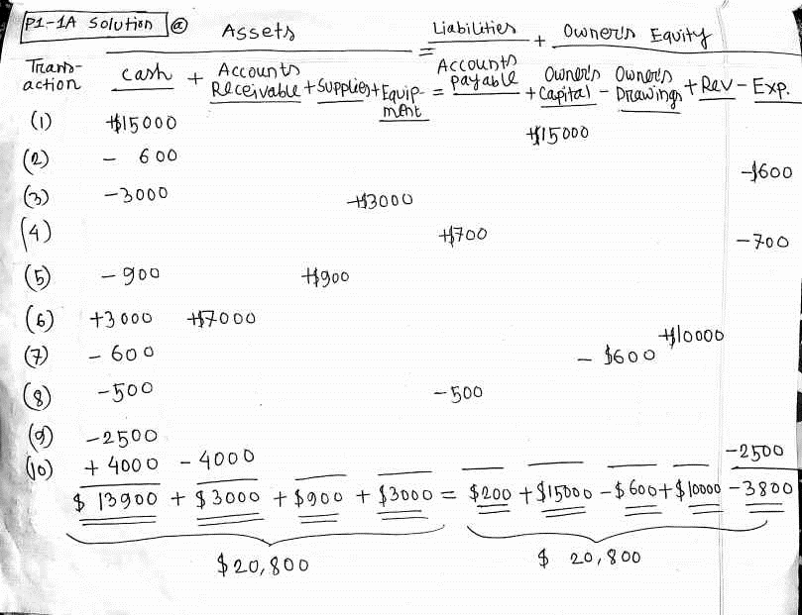

Slide 3
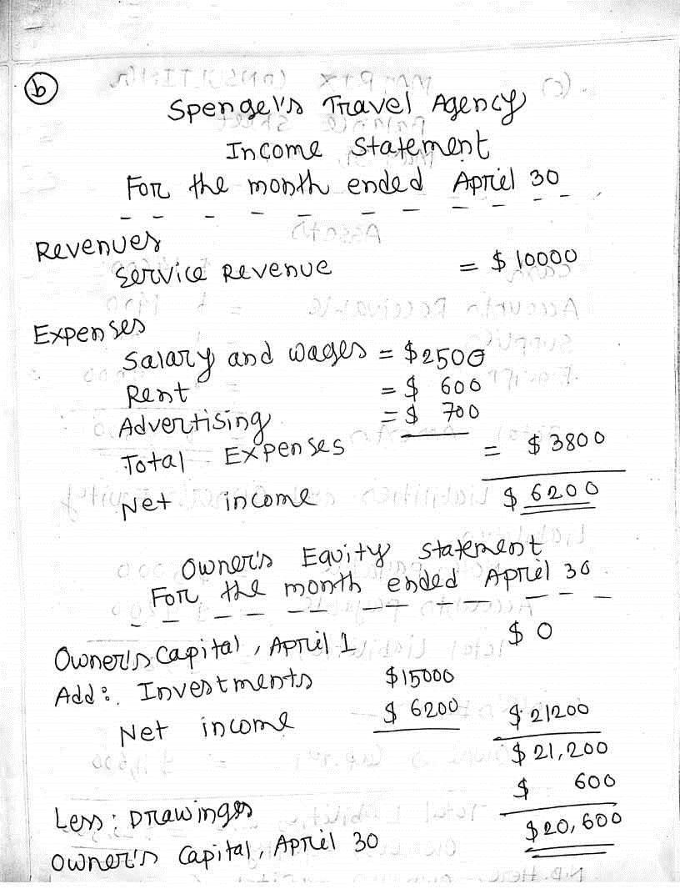

Slide 4
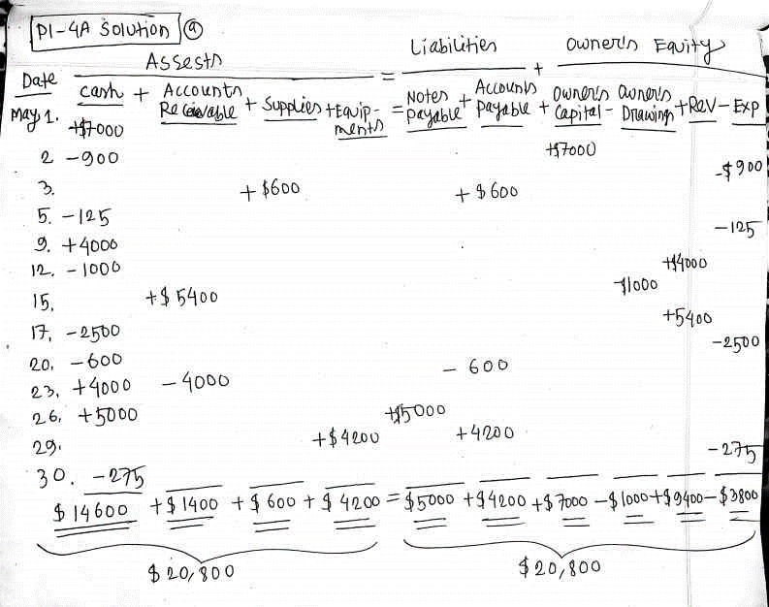

Slide 5
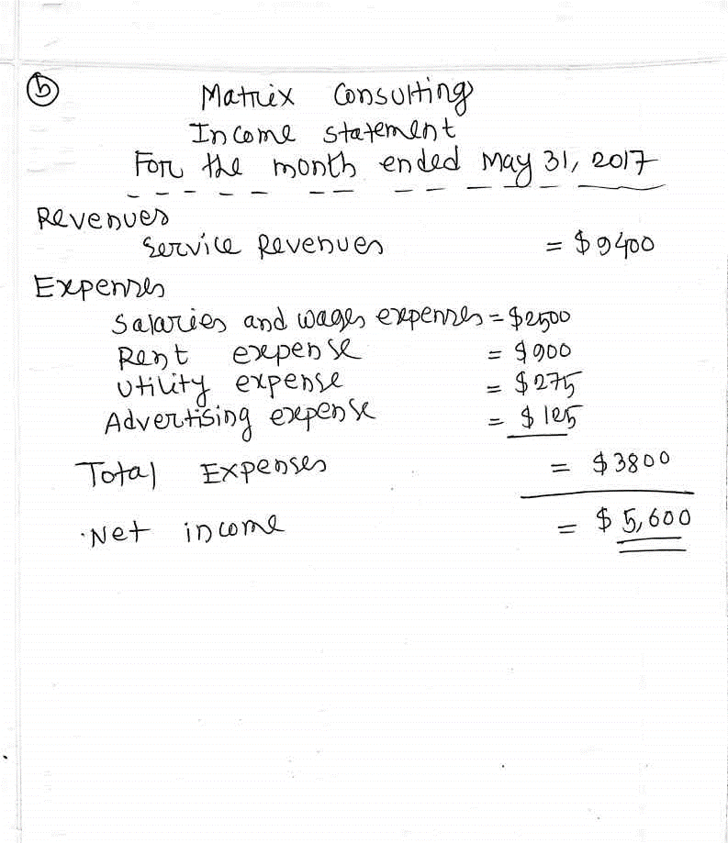

Slide 6
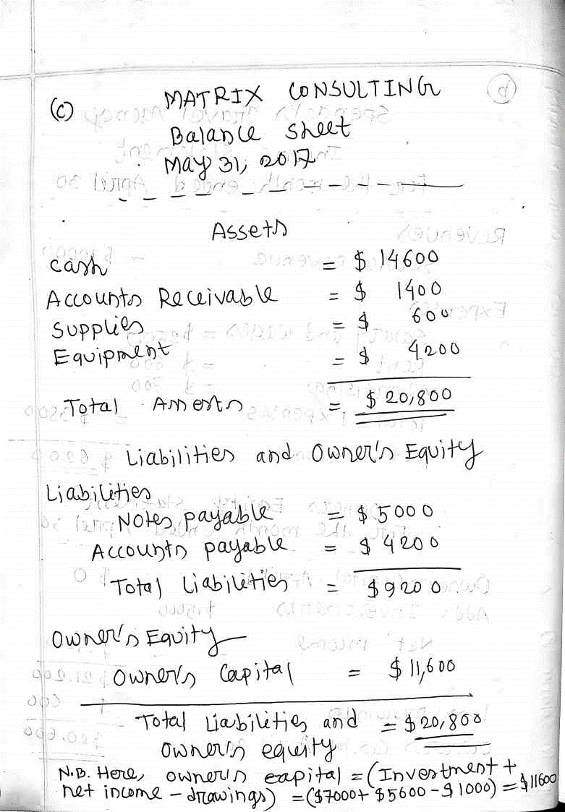

Slide 7
The End
Thank You
☺

